Slide 1


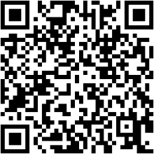
AI & Mental Health: Equipping Nurse Educators for a New Era
3rd Thursday with AI | Faculty Development Series | June 2025
Chris Hickman, MSIS, BSEInstructor, UAB School of Nursing

Slide 2

Why This Matters
1 in 5
32%
Mental Illness
Reduction
U.S. adults face mental illness annually; <50% receive treatment
Depression scores with AI chatbot interventions
<20%
Programs
Nursing programs include hands-on AI simulation in mental health

Slide 3






Setting the Stage: AI in Mental Health Care
AI as Amplifier
Enhances human empathy, not replaces it
Rising Demand
Provider shortages amid increasing needs
Reshaping Access
24/7 support for those suffering in silence

Slide 4

Core AI Technologies for Nursing Faculty
Purpose Built vs General Purpose AI
Purpose Built: Designed for a specific functionGeneral Purpose AI: Can write emails and care plans but isn't specifically trained for mental health or clinical tasks
Artificial Intelligence
The ability of computer systems to perform tasks that typically require human intelligence
Machine Learning
Flags high-risk patients by analyzing health data
Natural Language Processing
Powers therapeutic chatbots and screening tools
Virtual Reality
Creates realistic scenarios for clinical practice
Administrative AI
Streamlines lesson planning and grading

Slide 5
Use Case: AI Chatbots as Virtual Mental Health Assistants
Immediate Access
Student logs into university-provided chatbot
Therapeutic Support
Chatbot offers coping tools and monitors responses
Classroom Integration
Students experience both nurse and patient roles

Slide 6








Use Case: AI-Driven Risk Assessment
Data Scanning
Pattern Detection
AI reviews EHRs and activity patterns
Identifies subtle changes in mood or sleep
Holistic Care
Early Alerts
AI supports decisions, doesn't make them
Prompts intervention before crisis occurs

Slide 7


Use Case: VR and AI-Driven Virtual Patients
Dynamic Interaction
Diverse Scenarios
Safe Learning
AI patients respond to student questions realistically
Practice with depression, substance use, psychosis
Make mistakes without patient risk

Slide 8





The Benefits for Nursing Education
Scalable Learning
Personalized Feedback
Every student encounters complex scenarios
Immediate, individualized input
Flexible Support
Data-Driven Insight
Practice on student's own schedule
Track progress and tailor support

Slide 9





The Challenges: Technical, Practical, and Human
Access and Equity
Not all programs equally equipped
Faculty Readiness
Learning alongside students requires support
Bias and Accuracy
AI reflects training data limitations
Preserving Empathy
Technology supports, doesn't replace connection

Slide 10



Ethics & Regulation: HIPAA, FERPA, and Beyond
Data Protection
Never input real patient details into non-HIPAA tools
Transparency
Be clear about data use and storage
Critical Evaluation
Question how tools protect privacy and handle bias

Slide 11




Real-World Example: AI in the Classroom
Pre-Simulation Chatbots
Students interact as both nurse and patient
Reflection Process
Compare AI and human interaction differences
Measured Results
Reduced anxiety, better engagement in debriefings

Slide 12
Best Practices: AI & Mental Health in Nursing Education
Lead with Literacy
Ongoing faculty development in AI
Integrate, Don't Isolate
Complement, not replace human instruction
Champion Equity
Select AI with diverse representation
Clarify Boundaries
Clear guidelines on academic integrity
Center Empathy
Nurses as advocates, not algorithm followers
Support Evaluation
Gather ongoing feedback on AI impact

Slide 13



Interactive Demonstrations: AI & Mental Health in Action
Three hands-on opportunities to experience AI tools with guided discussion on responsible use and critical thinking.

Slide 14




Looking Ahead: Empowering the Next Generation
Stay Curious
Embrace continuous learning about AI advances
Collaborate
Share insights across nursing programs
Center Patients
Keep technology as tool, not focus of care

Slide 15

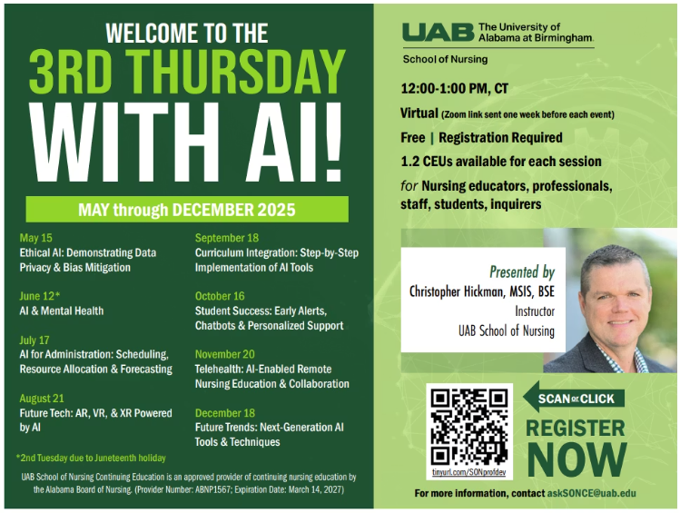
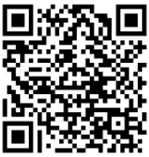
Next Steps
Stay tuned for upcoming sessions in this series, where we'll delve deeper into specific AI tools and their applications in nursing education.
Please scan the QR Code for a Survey Evaluation.

Slide 16

References
Fitzpatrick, K. K., Darcy, A., & Vierhile, M. (2022). Delivering cognitive behavior therapy to young adults with symptoms of depression and anxiety using a fully automated conversational agent (Woebot): A randomized controlled trial. JMIR Mental Health, 9(2), e23056.
National Institute of Mental Health. (2024). Mental Illness. https://www.nimh.nih.gov/health/statistics/mental-illness
UCSF School of Nursing. (2025). How UCSF Experts are Using Generative AI to Revolutionize Nursing Education. https://nursing.ucsf.edu/scienceofcaring/news/how-ucsf-experts-are-using-generative-ai-revolutionize-nursing-education
USAHS. (2024). AI in Mental Health: Transforming Care and Advancing Well-Being. https://www.usa.edu/blog/ai-in-mental-health-innovations-transforming-behavioral-health/
GovTech. (2024). AI to Assist Nursing Students With Clinical Simulations. https://www.govtech.com/education/higher-ed/ai-to-assist-nursing-students-with-clinical-simulations

Slide 17
Thank you!
3rd Thursday with AI | Faculty Development Series | June 2025
Chris Hickman, MSIS, BSEInstructor, UAB School of Nursing

